Slide 1
자료구조와 설계 Team Standing Comedy Week 1
20175532 신동진
20140661 신주환
20146136 오준오
20141001 이지호
20141405 최형준

Slide 2
목차
Icebreaking
Setting Team Leader
Meeting Time
Q&A

Slide 3
Icebreaking
신동진
신주환
최형준
오준오
이지호

Slide 4
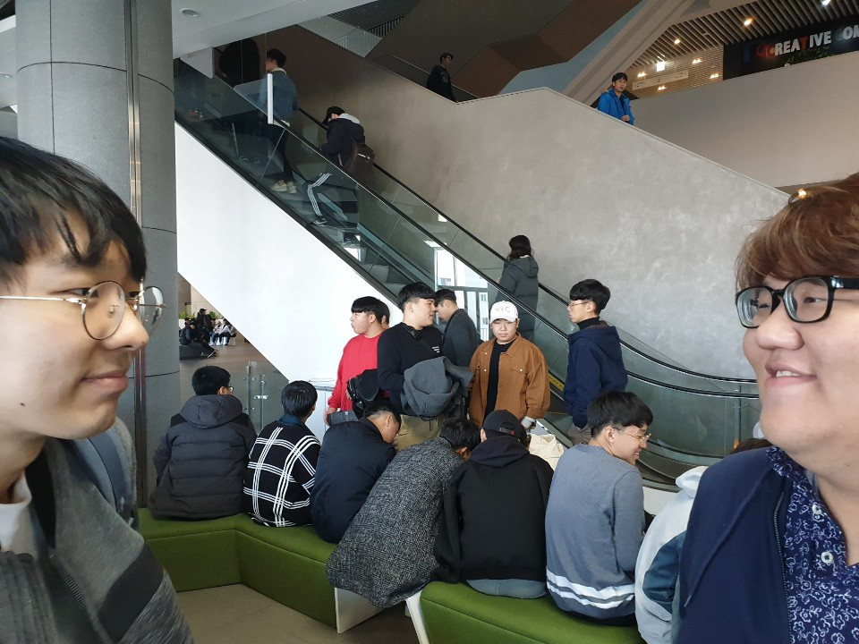
Icebreaking

Slide 5
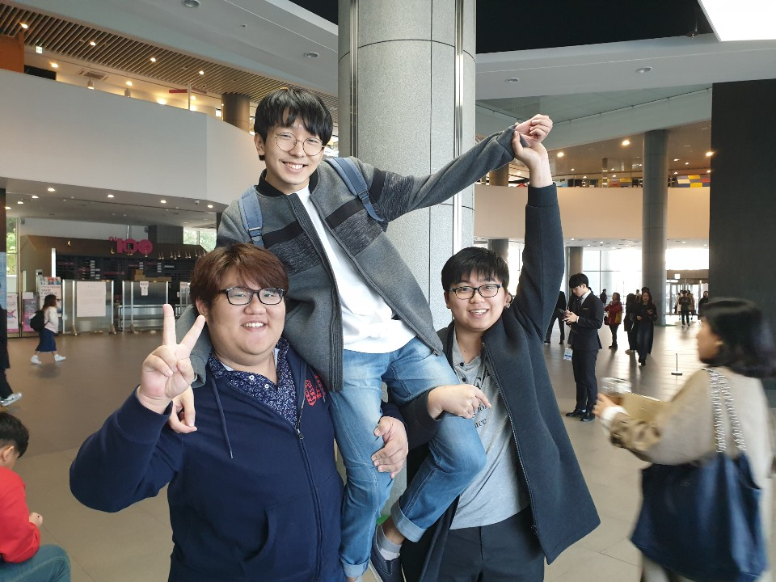
Icebreaking

Slide 6
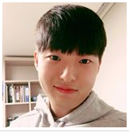
Setting Team Leader
Name : Joon Oh Oh
STD Number : 20146136
Major : Computer Science& it’s Engineering
Main Career : Three languages available
(Korean, Chinese, English)
GitHub : https://github.com/jooh95/310FreeSeat

Slide 7
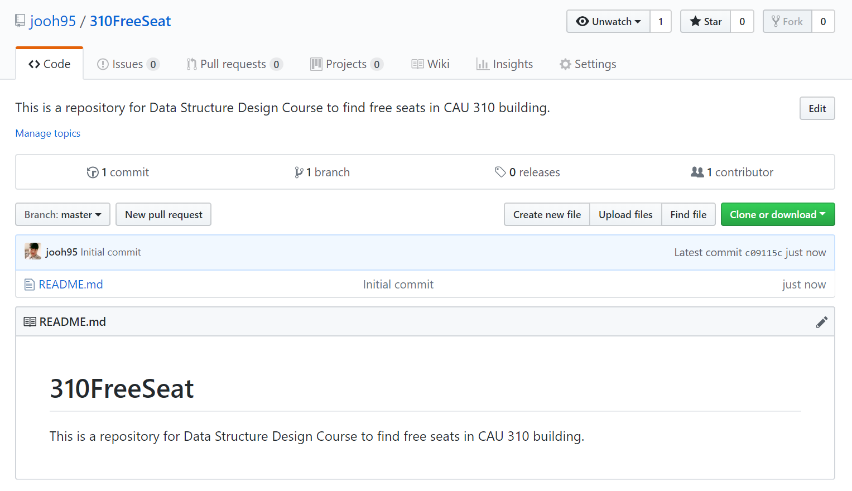

Slide 8
Meeting Time
Fri
(main)
Main meeting
Every week
Directional view / Sharing role
Tue
(sub)
Sub meeting
Only if needed
Feedback of classes

Slide 9
Q & A

